Slide 1

Alkali-activated slag with low water/binder-ratio
Alexander Wetzel, Tim Schade, Bernhard Middendorf

Slide 2
Motivation and content of presentation
Aim: An ultra-high performance concrete without any Portland cement
UHPC has a high durability and strength due to
  optimised packing density with the use of reactive fines (silica fume)
  low water/binder ratio (0.2)
  → needs superplasticizers
  Three different approaches to reduce the water/binder ratio:
Using silica fume as additive to improve workability and strength
Using nanosilica as additive to improve workability and strength
Testing different superplasticizers (Polycarboxylatether - PCE)
  MPEG-based (commercially availabe), APEG (pure), Unknown (commercially availabe)
Applications
Notes:
methacrylate ester (MPEG),
allyl ether (APEG

Slide 3
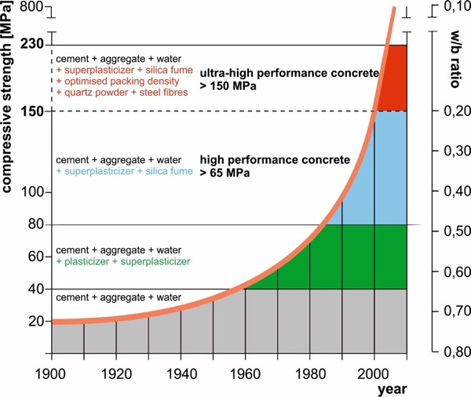
What is UHPC? Development in concrete technology
acc. to Prof. Middel

Slide 4
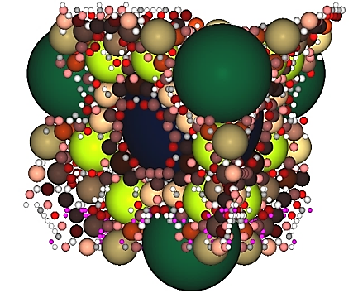

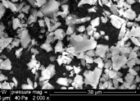
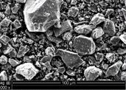
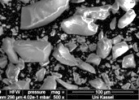
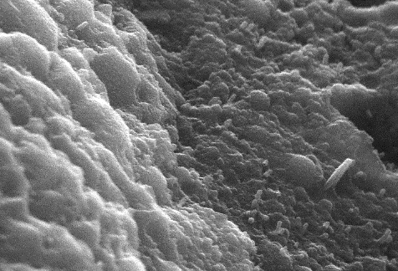
Calculation and increase of packing density of fine particles
State of the art
→ optimization of packing density
$$D = \frac{1}{1+k_{0}−\sum_{i=1}^{n}{a_{s,i}∙s_{i}}}$$
Improved strength
and durability
silica fume
additive 1
clinker
additive 2
dense cement matrix
aggregate

Slide 5
Alkali Activated Material - basic formulation
Notes:
Volume percentage

Slide 6
Rheology of AAM, estimated in mixer
→ decrease of viscosity due to increase of silica fume
w/b ratio 0.25

Slide 7
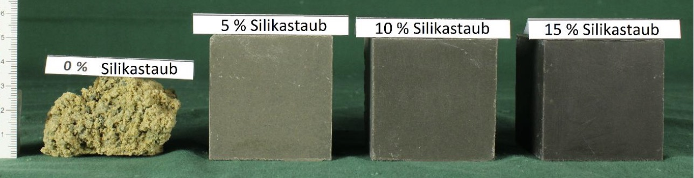
Compressive strength in the range of ultra-high performance concrete
Thermal curing
60 °C / 24h
4 % silica fume
8 % silica fume
12.5 % silica fume
0 % silica fume
 |  | SF4 | SF8 | SF12.5 | SF4-MK2.7 | SF8-MK2.7 | SF12.5-MK2.7
Silica fume (SF) | % | 4 | 8 | 12.5 | 4 | 8 | 12.5
Metakaolin (MK) | % | 0 | 0 | 0 | 2.7 | 2.7 | 2.7
Packing density | % | 76.8 | 79.9 | 83.3 | 76.9 | 80.0 | 83.2
Compressive strength, 28 days | MPa | 149.8 | 168.3 | 178.6 | 163.8 | - | 157.0

Slide 8
Microporosity (measured by mercury intrusion porosimetry)
sample | Gel-porosity 0.003-0.03 µm (vol%) | Capillary-porosity 0.03-10 µm (vol%) | Air voids 10-100 µm (vol%)
SF 4 (28d) | 4.73 | 1.37 | 2.55
SF 4 MK 2.7 | 4.47 | 0.9 | 3.82
UHPC – K18 | 0.97 | 0.58 | 1.29

Slide 9
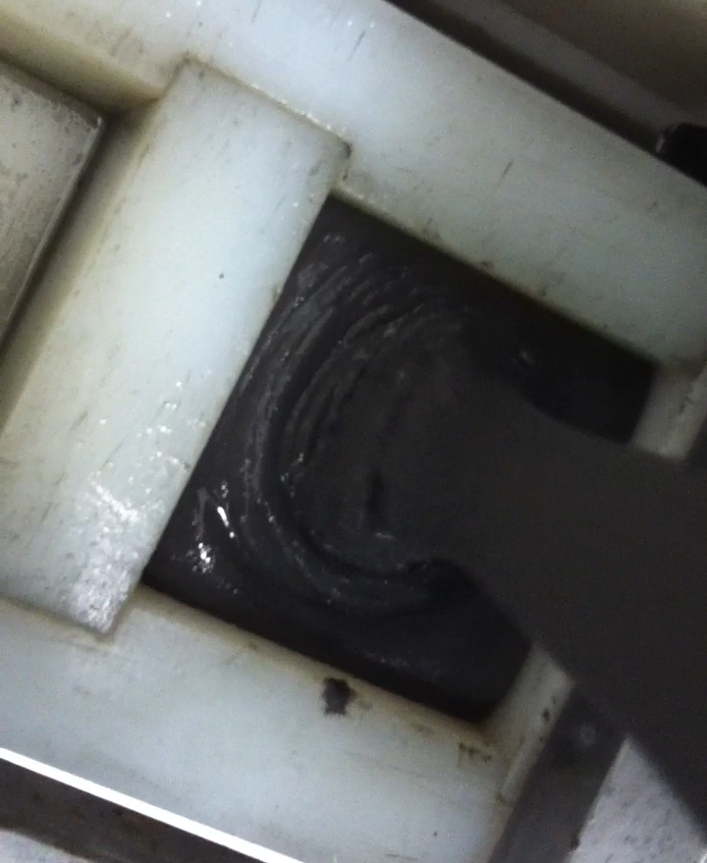
Influence on rheology by nanosilica
w/b ratio 0.25
Notes:
Video 9.5-0.5

Slide 10
Influence on compressive strength by nanosilica
w/b ratio 0.25
7 days

Slide 11
Mini-Slump Test under variation of superplasticizer type and amount
w/b-ratio 0.2
Conte & Plank. Cement and Concrete Research 116 (2019) 95–101

Slide 12
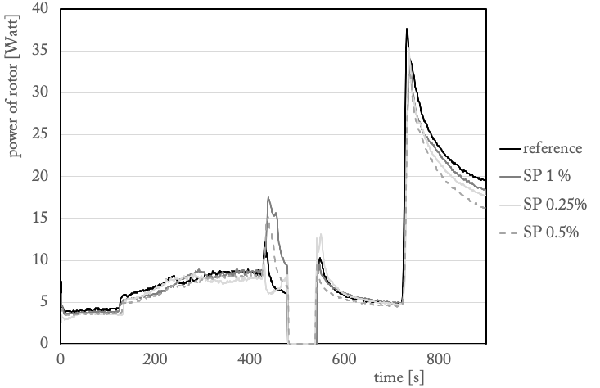
Improving workability by using superplasticizers (SP 1 - APEG)
w/b-ratio 0.2

Slide 13
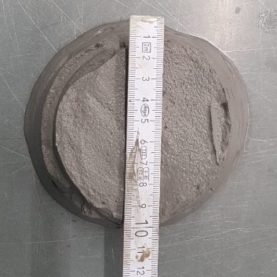
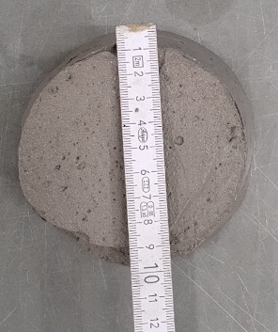
Variation of activator concentration and silica fume content
2 molar KOH
37 % slag
5% silica fume
w/b ratio 0.5
2 molar KOH
37 % slag
5% silica fume
w/b ratio 0.5
+0.1 % SP

Slide 14
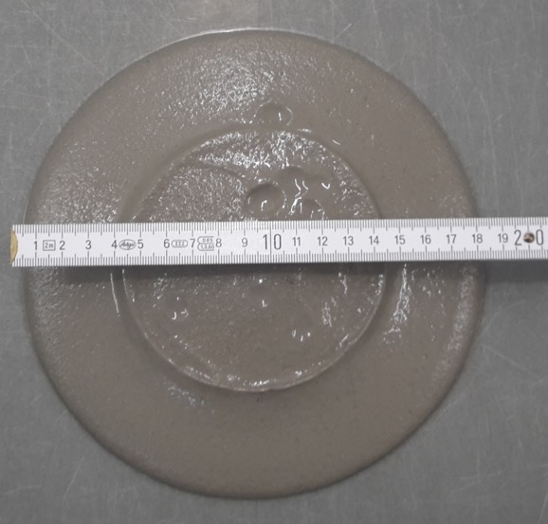
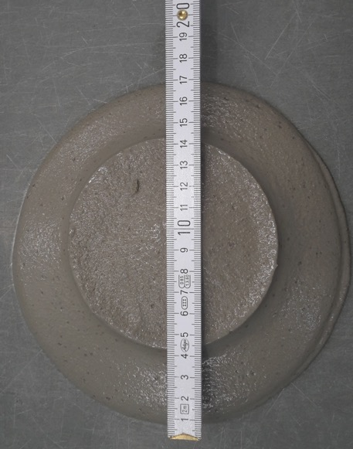
Variation of activator concentration and silica fume content
2 molar KOH
39.5 % slag
2.5% silica fume
w/b ratio 0.5
2 molar KOH
39.5 % slag
2.5% silica fume
w/b ratio 0.5
+0.1 % SP

Slide 15
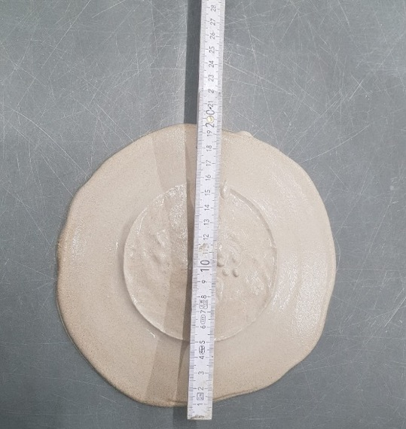
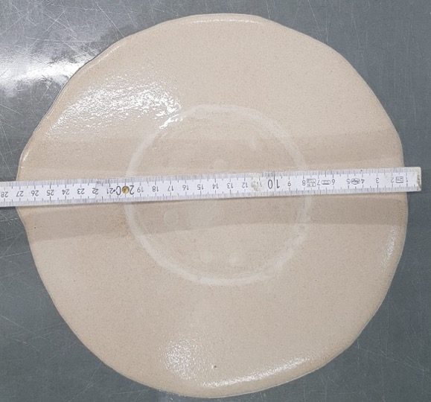
Variation of activator concentration and silica fume content
2 molar KOH
42 % slag
w/b ratio 0.5
+0.1 % SP
2 molar KOH
42 % slag
w/b ratio 0.5

Slide 16
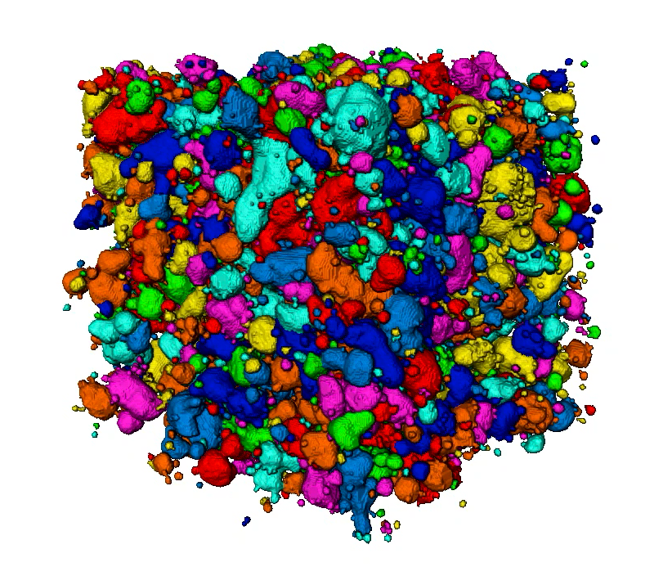
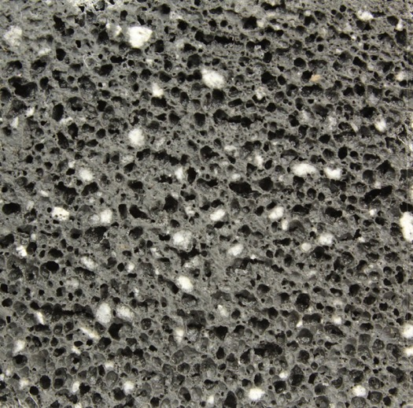
Microstructure of foam – shape of pores
(20 vol% SF, 5 vol% MK, LWA and basalt fibres, w/b 0.25)
2d cut
3d µ-CT
ρ=600 kg/m³
compressive strength 3 MPa

Slide 17
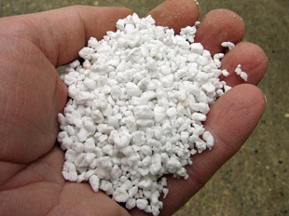
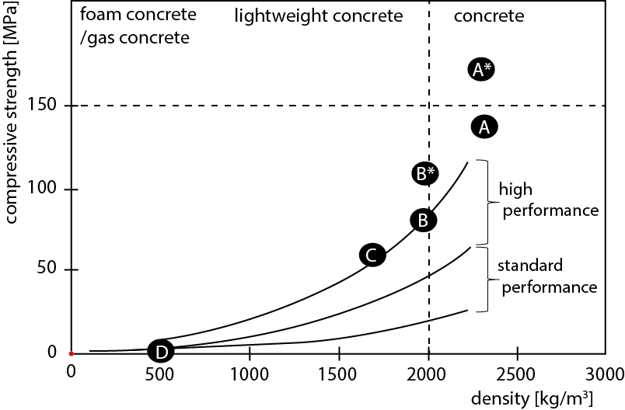
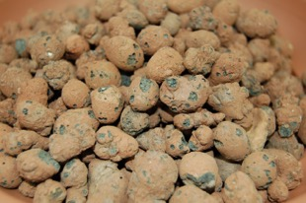
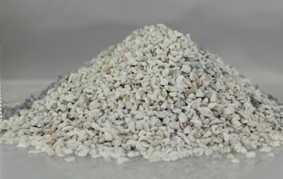
perlite
expanded clay
7 days
pumice
 | Aggregates coarse | Aggregate fine | w/b ratio | Thermal curing (60°C) | Al-powder
A | Quartz sand | Quatzt powder | 0.20 | no | no
A* | Quartz sand | Quartz powder | 0.20 | yes | no
B | Expanded clay (50) | Perlite (100) | 0.20 | no | no
B* | Expanded clay (50) | Perlite (100) | 0.20 | yes | no
C | Expanded clay (50) Perlite (50) | Pumice (50) | 0.20 | no | no
D | Perlite (100) | Perlite (100) | 0.25 | no | yes

Slide 18
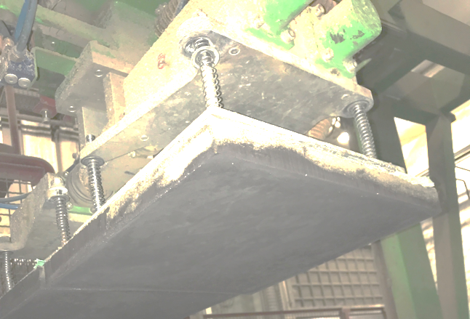
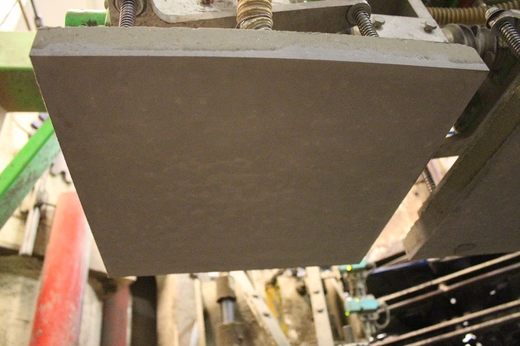
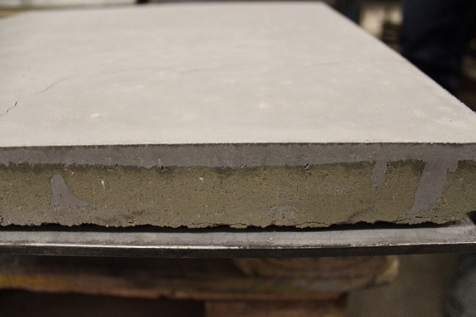

AAM paving slab – OPC free
Paving slabs with
black pigments

Slide 19
Conclusions
Ultra-high performance alkali activated material based on slag
Decrease of viscosity due to use of silica fume, → low w/b-ratio with SF is possible
Slight improve of rheology by using nanosilica, but decrease in compressive strength
APEG superplasticizers works good in systems without silica fume

Slide 20
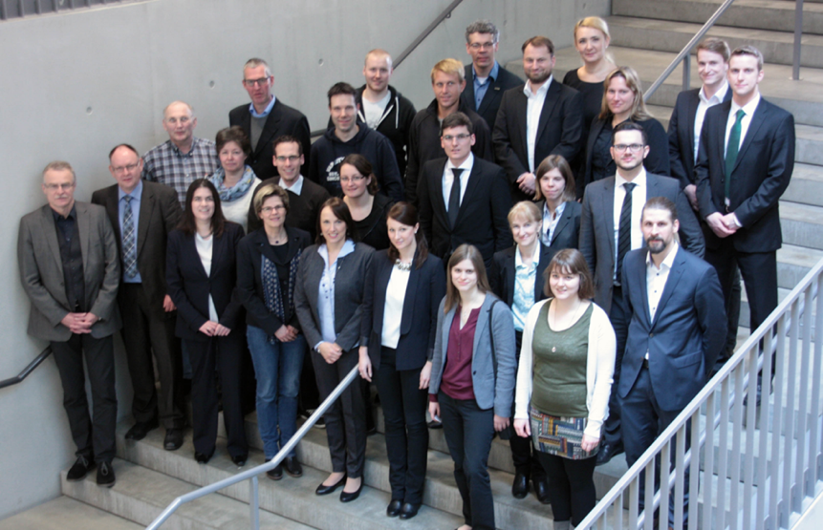

Thank your for your interest!
5th International Symposium on
Ultra-High Performance Concrete and
High Performance Construction Materials
www.hipermat.com
Submit abstracts until 30th of April 2019
11th-13th March 2020
in Kassel (Germany)
alexander.wetzel@uni-kassel.de

Slide 22
Properties of precursors
 | slag | silica fume | metakaolin
SiO₂ | 35.80 | 96.57 | 52.67
Al₂O₃ | 11.70 | 0.06 | 42.91
Fe₂O₃ | 0.37 | 0.06 | 0.33
CaO | 43.80 | 0.51 | 0.03
MgO | 5.80 | 0.25 | 0.07
MnO | 0.30 | 0.02 | 0.01
K₂O | 0.40 | 0.73 | 0.53
Na₂O | 0.20 | 0.16 | 0.04
SO₃ | 0.17 | 0.12 | 0.04
TiO₂ | 1.08 | 0.01 | 0.03
LOI | 0.27 | 1.41 | 3.25
spec. surf. [cm²/g] | 3900 | 218000 | 91100
d₁₀ [µm] | 1.2 | 0.3 | 1.5
d₅₀ [µm] | 10.4 | 0.6 | 5.2
d₉₀ [µm] | 31.7 | 1.9 | 20.83

Slide 23
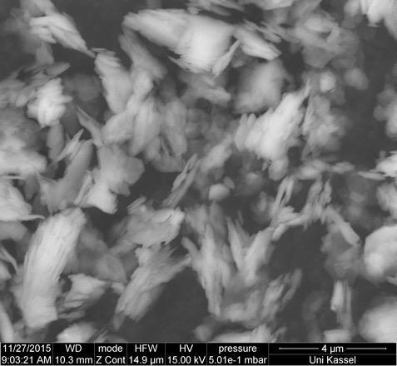
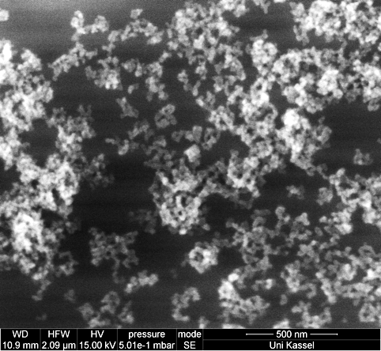
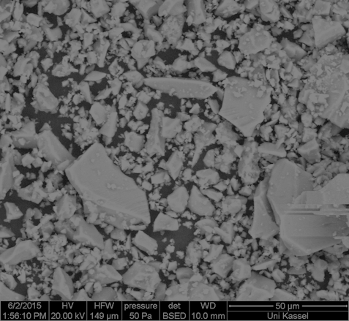
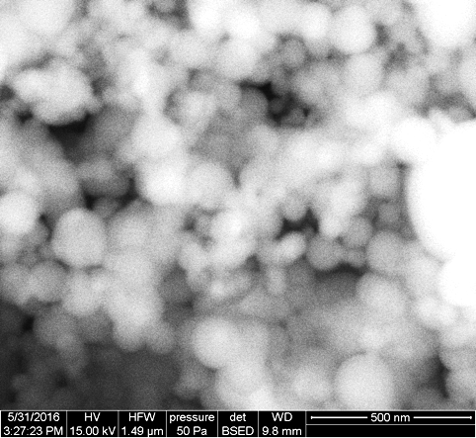
Metakaolin
←
Nanosilica
→
Slag
←
Silica fume
→

Slide 24
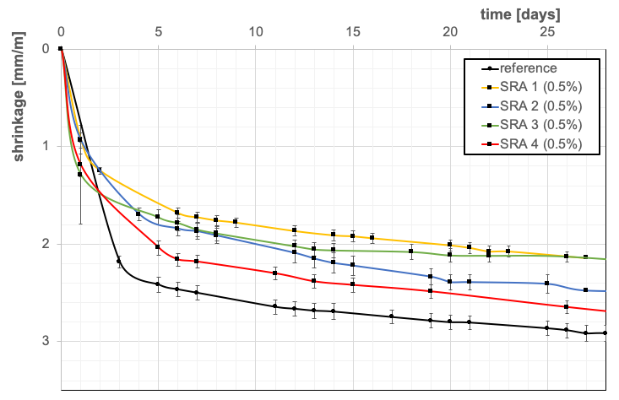
Shrinkage reduction agents
w/b-ratio 0.2

Slide 25
Compressive Strength
w/b-ratio 0.2

Slide 26
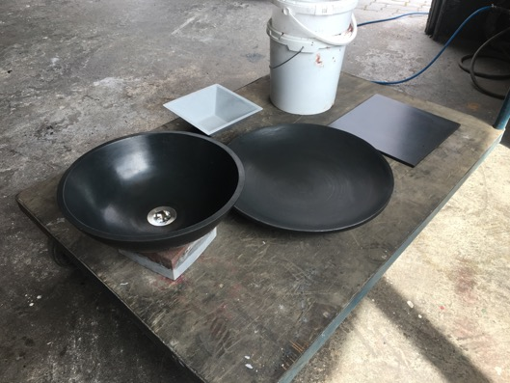
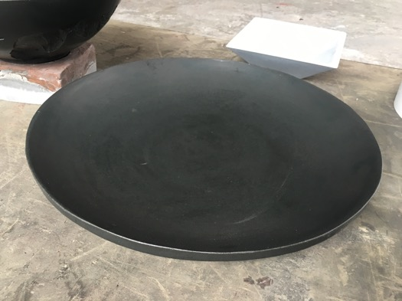
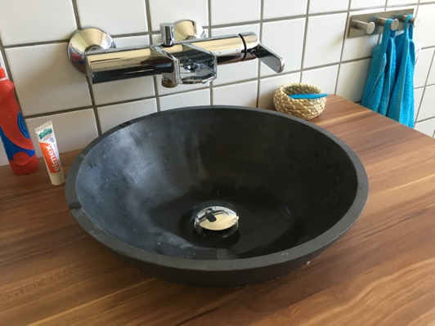
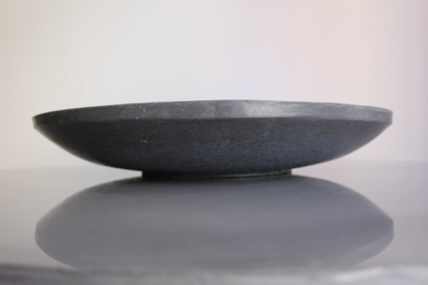
Ceramic like AAM applications: (wash) bowls

Slide 27
Setting time in correlation with silica fume content
15 % silica fume
12.5 % silica fume
10 % silica fume
5 % silica fume

Slide 28
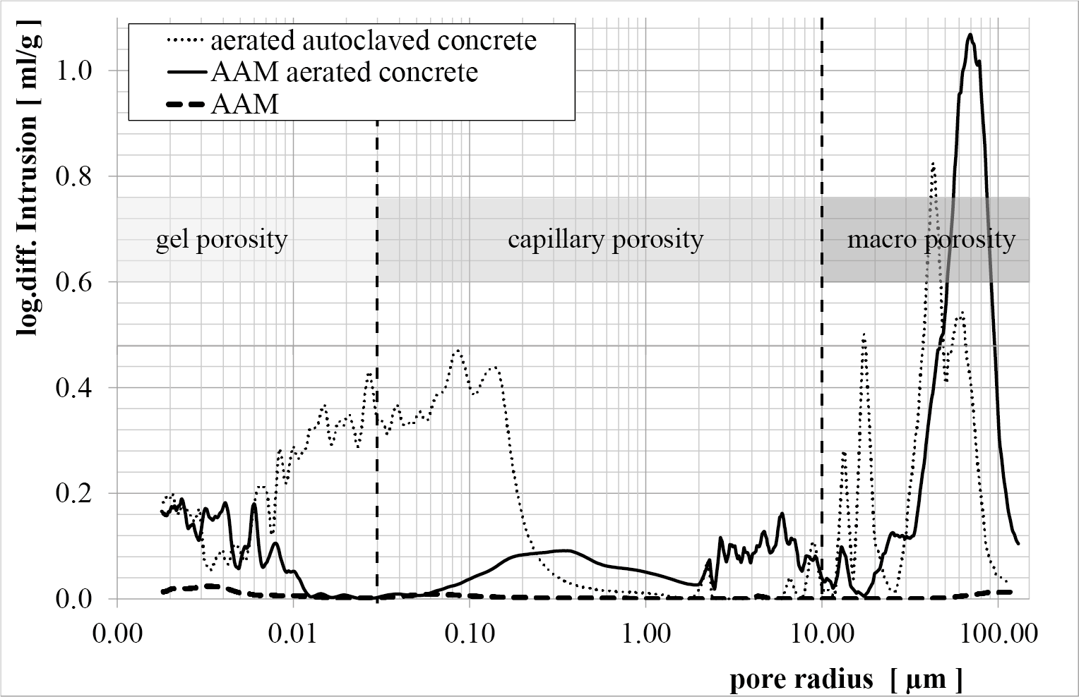
Microporosity (measured by mercury intrusion porosimetry)

Slide 29
Phase development

Slide 30
Grain size distribution for packing density optimisation

